Slide 1

AI Services
Success Stories
2025

Slide 2
Our Understanding of the Problem Statement
Business users upload various knowledge documents in the accelerator. Users often need to extract specific insights or answers from these documents. These documents contain critical information needed for decision-making.AI was introduced to enable natural language querying and streamline information retrieval.

Slide 3
Solution Approach: Enhanced Business Workflow/ Function
Function | AI/GenAI Contribution
Document Parsing | NLP models extract structure and meaning from unstructured text
Semantic Search | Embedding-based search retrieves contextually relevant information
Question Answering | GenAI understands user intent and generates accurate responses
Summarization | Condenses lengthy documents into digestible insights
Continuous Learning | Improves over time based on user interactions and feedback

Slide 4
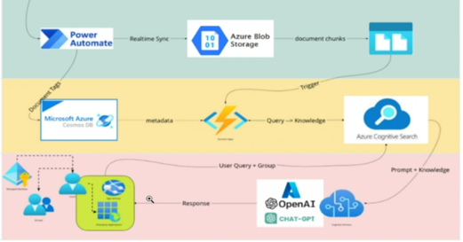
Technical Solution: Architecture, Tech Stack & Challenges Resolved

Slide 5
Business Benefits Delivered
Business users frequently upload various knowledge documents (e.g., reports, manuals, guidelines) into a centralized utility. These documents contain critical information essential for operational and strategic decision-making. Traditionally, users had to manually search or browse through these documents to find relevant insights, which was time-consuming and inefficient.

Slide 6
Getting to the
Future. Faster.
Together.

